Slide 1
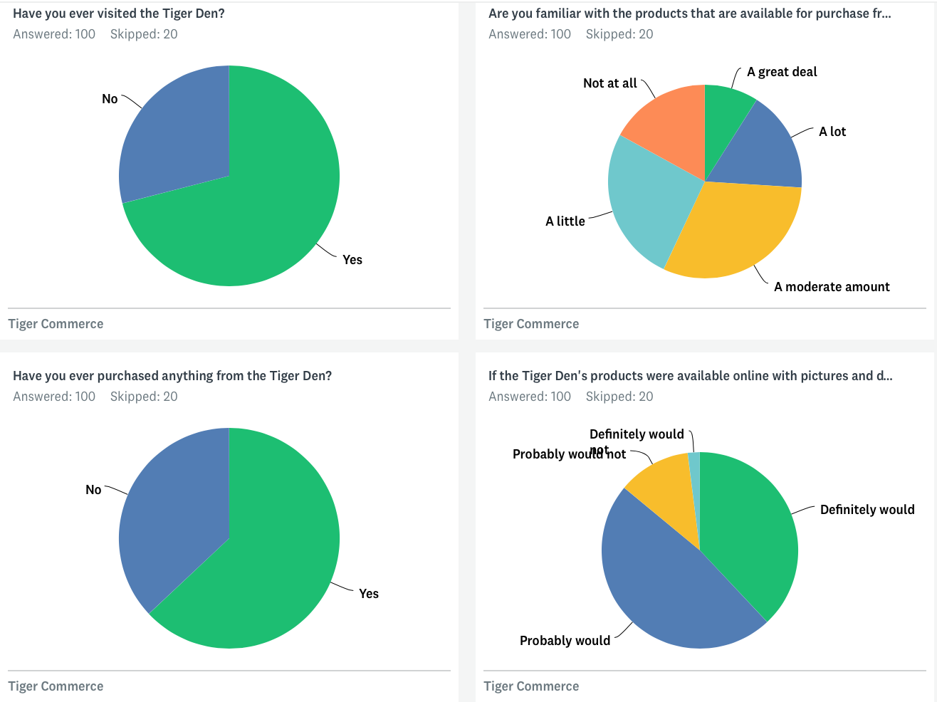
A demand for WAB merchandise availability both on and offline.
Are you familiar with the products that are available for purchase from the Tiger Den?
If the Tiger Den's products were available online with pictures and descriptions, would you visit the e-commerce site?
Survey with 100 respondents who responded to a general call to answer 10 questions.

Slide 2
8. Workflow
A) Ordering
Purchase to refill stock
Order
in shop
Product sold out
Check stock inventory
Checking online orders
Product available
Delivery to client
Stock
(shop and storage)

Slide 3
8. Workflow
B1) Suppliers (shop delivery)
Check stock inventory
Determine deficit item(s) and amounts
Order the items from supplier, i.e. WABX
Check correct delivery
Stock
(shop and storage)

Slide 4
8. Workflow
B2) Suppliers (direct shipment)
Give supplier detailed order information
Check correct delivery via track &trace
Check order

Slide 5
8. Workflow
C) Fulfillment (actions for Tiger Den volunteers)
Take the items out of the shop or the storage
Print out address of customer
Take the order
Collect all items
Package the items and send to express firm
Check delivery via Track and Trace.

